Slide 1

Decision Tree

Slide 2
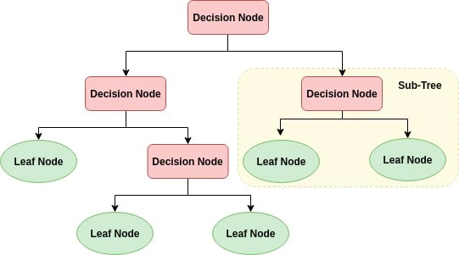
Decision Tree
A decision tree is a flowchart-like tree structure where an internal node represents feature(or attribute), the branch represents a decision rule, and each leaf node represents the outcome.
The topmost node in a decision tree is known as the root node. It learns to partition on the basis of the attribute value. It partitions the tree in recursively manner call recursive partitioning.
This flowchart-like structure helps you in decision making. It's visualization like a flowchart diagram which easily mimics the human level thinking. That is why decision trees are easy to understand and interpret.
https://www.datacamp.com/community/tutorials/decision-tree-classification-python

Slide 3
How does the Decision Tree algorithm work?
The basic idea behind any decision tree algorithm is as follows:
Select the best attribute using Attribute Selection Measures(ASM) to split the records.
Make that attribute a decision node and breaks the dataset into smaller subsets.
Starts tree building by repeating this process recursively for each child until one of the condition will match:
All the tuples belong to the same attribute value.
There are no more remaining attributes.
There are no more instances.

Slide 4
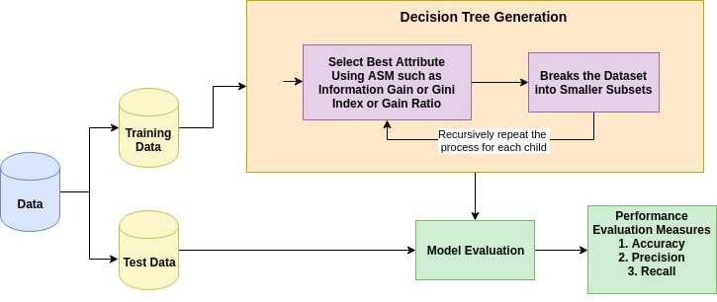
Process

Slide 5
Attribute Selection Measures
Attribute selection measure is a heuristic for selecting the splitting criterion that partition data into the best possible manner. It is also known as splitting rules because it helps us to determine breakpoints for tuples on a given node.
ASM provides a rank to each feature(or attribute) by explaining the given dataset.
Best score attribute will be selected as a splitting attribute.
In the case of a continuous-valued attribute, split points for branches also need to define.
Most popular selection measures are Information Gain, Gain Ratio, and Gini Index.

Slide 6
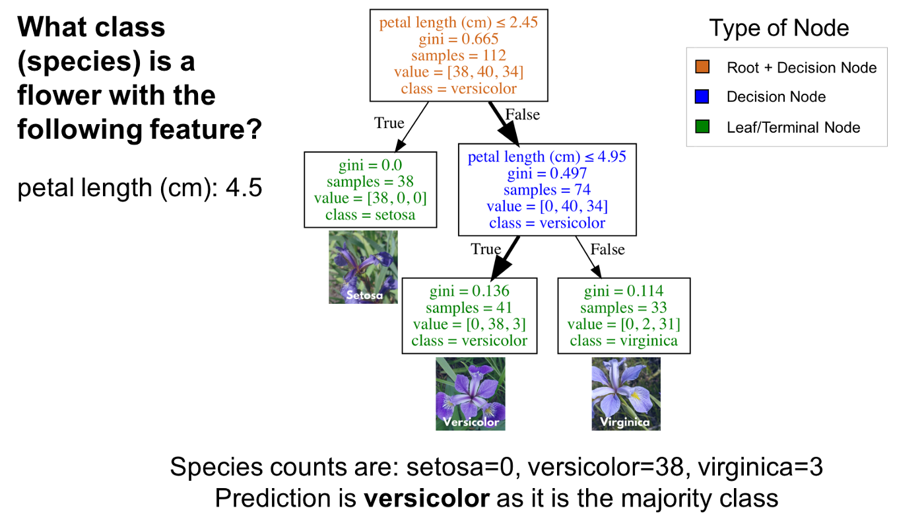

Slide 7
Classification Trees
Classification trees are essentially a series of questions designed to assign a classification.
The image below is a classification tree trained on the IRIS dataset (flower species).
Root (brown) and decision (blue) nodes contain questions which split into subnodes.
The root node is just the topmost decision node. In other words, it is where you start traversing the classification tree.
The leaf nodes (green), also called terminal nodes, are nodes that don’t split into more nodes. Leaf nodes are where classes are assigned by majority vote.

Slide 8


Slide 9
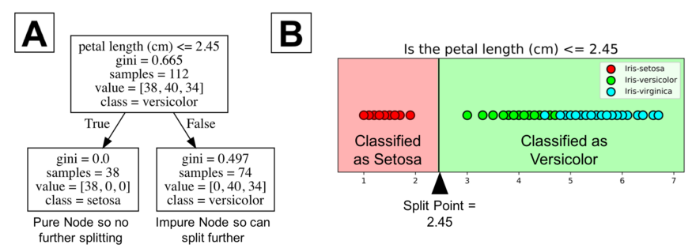
How are Classification Trees Grown?

Slide 10
Explanation of previous diagram
A classification tree learns a sequence of if then questions with each question involving one feature and one split point.
Look at the partial tree below (A), the question, “petal length (cm) ≤ 2.45” splits the data into two branches based on some value (2.45 in this case). The value between the nodes is called a split point.
A good value (one that results in largest information gain) for a split point is one that does a good job of separating one class from the others.
Looking at part B of the figure below, all the points to the left of the split point are classified as setosa while all the points to the right of the split point are classified as versicolor.

Slide 11
Explanation of previous diagram
The figure shows that setosa was correctly classified for all 38 points. It is a pure node. Classification trees don’t split on pure nodes.
It would result in no further information gain. However, impure nodes can split further. Notice the rightside of figure B shows that many points are misclassified as versicolor. In other words, it contains points that are of two different classes (virginica and versicolor).
Classification trees are a greedy algorithm which means by default it will continue to split until it has a pure node. Again, the algorithm chooses the best split point (we will get into mathematical methods in the next section) for the impure node.

Slide 12
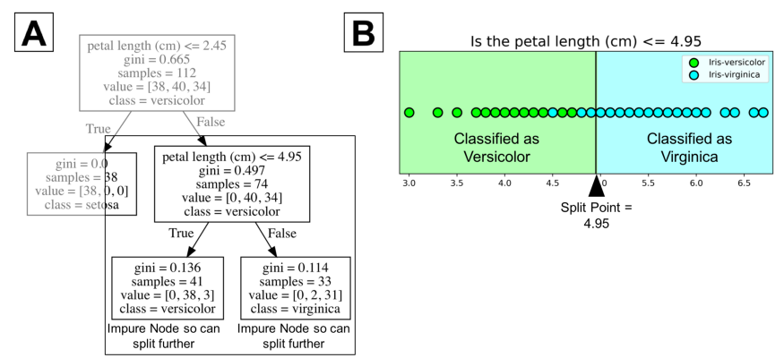
Next Step

Slide 13
Explanation
In the image, the tree has a maximum depth of 2 . Tree depth is a measure of how many splits a tree can make before coming to a prediction.
This process could be continued further with more splitting until the tree is as pure as possible. The problem with many repetitions of this process is that this can lead to a very deep classification tree with many nodes.
This often leads to overfitting on the training dataset. Luckily, most classification tree implementations allow you to control for the maximum depth of a tree which reduces overfitting.
For example, Python’s scikit-learn allows you to preprune decision trees. In other words, you can set the maximum depth to stop the growth of the decision tree past a certain depth.
For a visual understanding of maximum depth, you can look at the image on next slide.

Slide 14
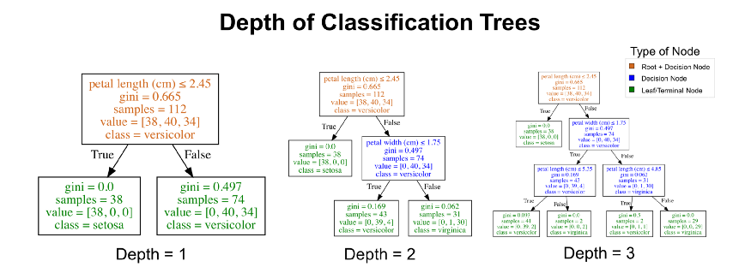

Slide 15

The Selection Criterion
This is really about understanding what is a good split point for root/decision nodes on classification trees.
Decision trees split on the feature and corresponding split point that results in the largest information gain (IG) for a given criterion (gini or entropy in this example). Loosely, we can define information gain as

Slide 16
Information Gain
Shannon invented the concept of entropy, which measures the impurity of the input set.
In physics and mathematics, entropy referred as the randomness or the impurity in the system.
In information theory, it refers to the impurity in a group of examples.
Information gain is the decrease in entropy.
Information gain computes the difference between entropy before split and average entropy after split of the dataset based on given attribute values.

Slide 17
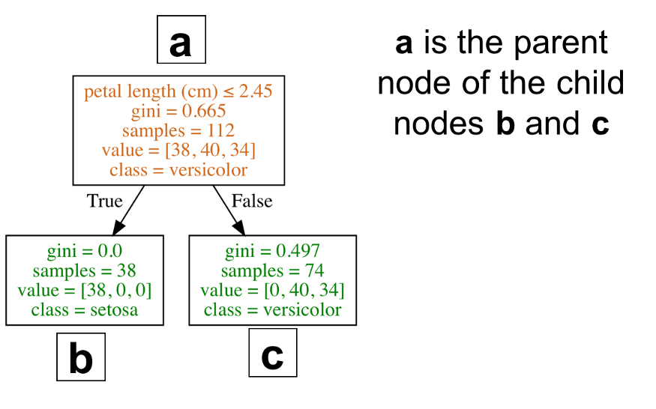

Slide 18
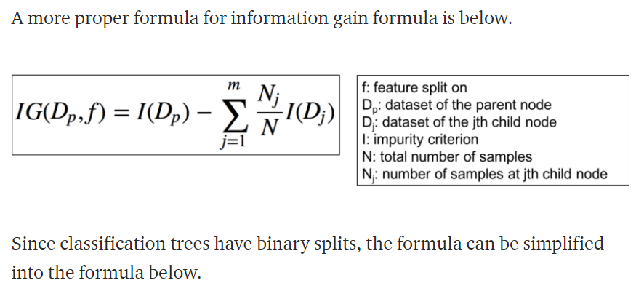

Slide 19
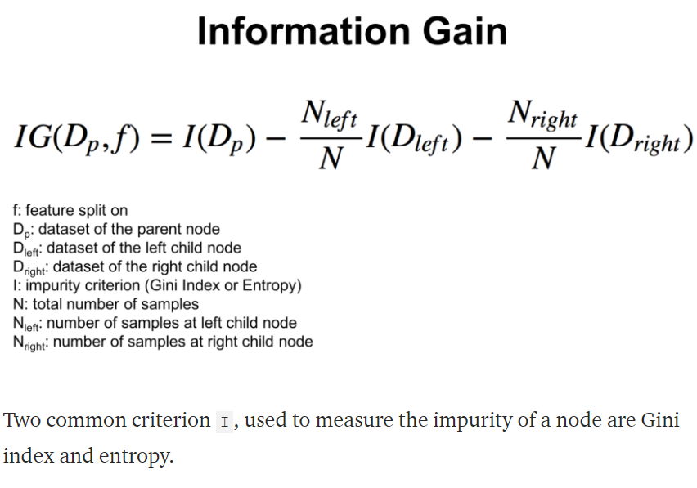

Slide 20
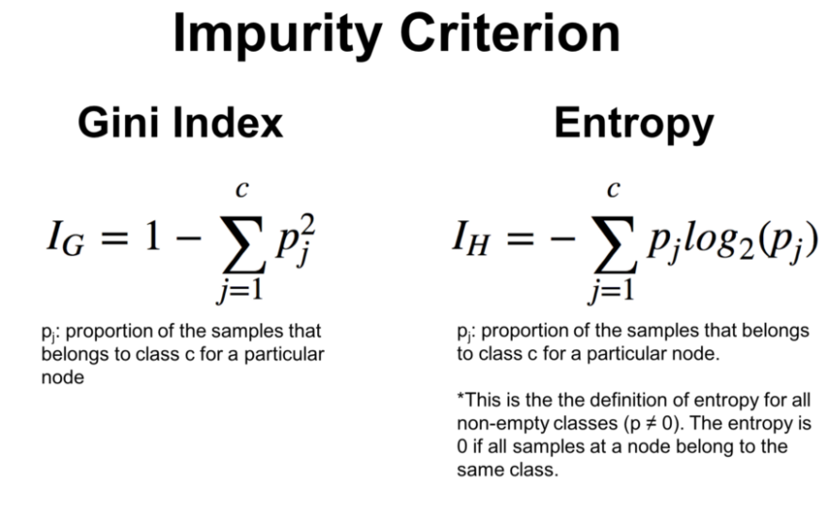

Slide 21
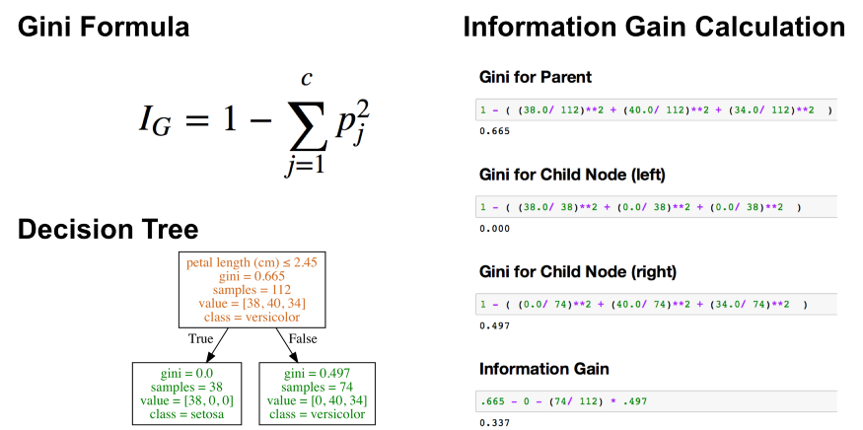

Slide 22
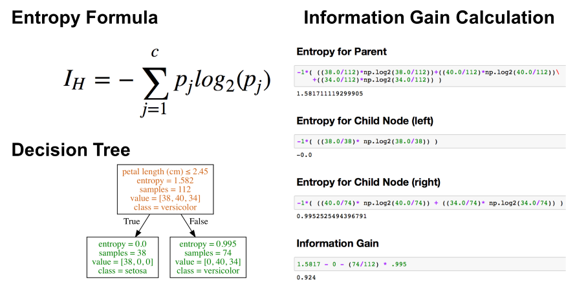

Slide 23
Gain Ratio
Information gain is biased for the attribute with many outcomes. It means it prefers the attribute with a large number of distinct values.
For instance, consider an attribute with a unique identifier such as customer_ID has zero info(D) because of pure partition.
This maximizes the information gain and creates useless partitioning.
Gain ratio handles the issue of bias by normalizing the information gain using Split Info.
Examples: Java implementation of the C4.5 algorithm is known as J48, which is available in WEKA data mining tool. C4.5, an improvement of ID3, uses an extension to information gain known as the gain ratio

Slide 24
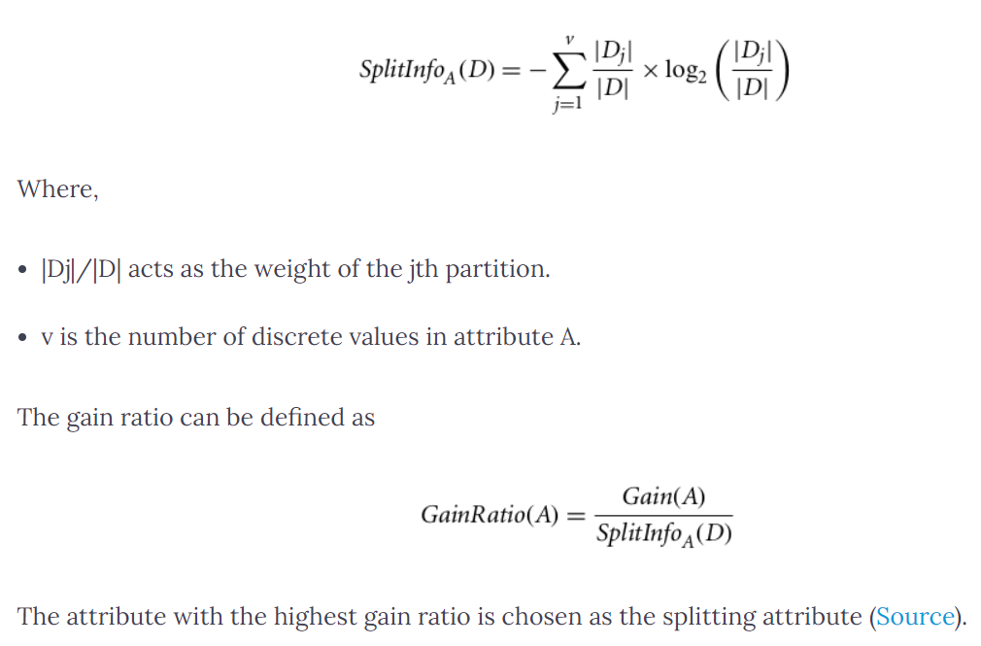

Slide 25
Task
Read “Classification Trees Using Python (Feature Importance). Pdf” uploaded on Brightspace.
https://www.kaggle.com/prashant111/decision-tree-classifier-tutorial (Optional) → if interested in detailed implementation with check on overfitting and underfitting problems
Reference →
https://towardsdatascience.com/understanding-decision-trees-for-classification-python-9663d683c952

Slide 26
Pros
Decision trees are easy to interpret and visualize.
It can easily capture Non-linear patterns.
It requires fewer data preprocessing from the user, for example, there is no need to normalize columns.
It can be used for feature engineering such as predicting missing values, suitable for variable selection.
The decision tree has no assumptions about distribution because of the non-parametric nature of the algorithm.

Slide 27
Cons
Sensitive to noisy data. It can overfit noisy data.
The small variation(or variance) in data can result in the different decision tree. This can be reduced by bagging and boosting algorithms.
Decision trees are biased with imbalance dataset, so it is recommended that balance out the dataset before creating the decision tree.

